Slide 1
Sentiment Analysis Of Amazon Product Reviews 😊😐😠
Made by :- Ankur Kumar

Slide 2
What is Sentimental Analysis
Sentiment analysis, also known as opinion mining or sentimental analysis, is a natural language processing technique used to determine the sentiment or emotional tone expressed in a piece of text. The goal of sentiment analysis is to automatically identify and classify opinions as positive, negative, or neutral.
Text Preprocessing: This step involves cleaning the text data by removing noise such as punctuation, special characters, and stopwords (commonly used words like "and", "the", "is", etc.).
Tokenization: The text is broken down into smaller units, typically words or phrases, known as tokens.
Sentiment Classification: In this step, machine learning algorithms or lexicon-based approaches are used to classify the sentiment of each token or the overall sentiment of the text. Machine learning approaches often involve training a model on labeled data where the sentiment of the text is already known.
Evaluation: After sentiment classification, the accuracy of the model is evaluated using metrics such as accuracy, precision, recall, and F1-score.
Overall, sentiment analysis provides valuable insights into public opinion, allowing businesses and organizations to make data-driven decisions and improve customer experiences.

Slide 3
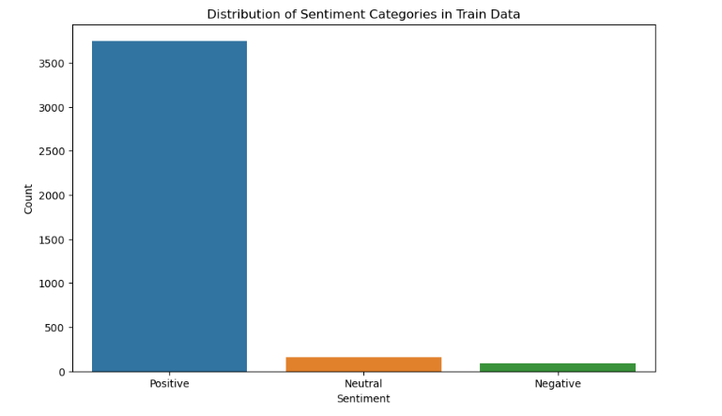
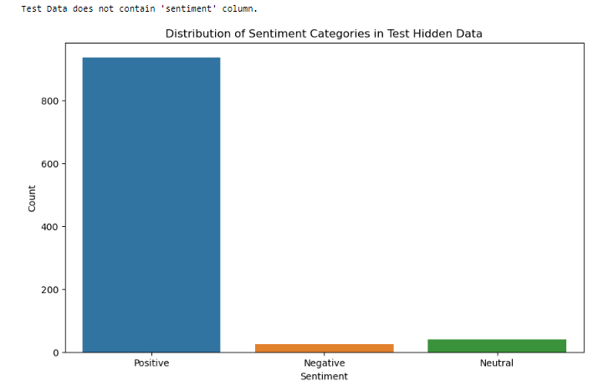
Distribution of Sentiment Categories
The distribution of sentiment categories refers to the breakdown of sentiment labels within a dataset or a set of texts. Sentiment analysis typically classifies text into one of several categories, such as positive, negative, or neutral. The distribution provides insights into the overall sentiment makeup of the dataset and helps understand how opinions are distributed across different categories.

Slide 4
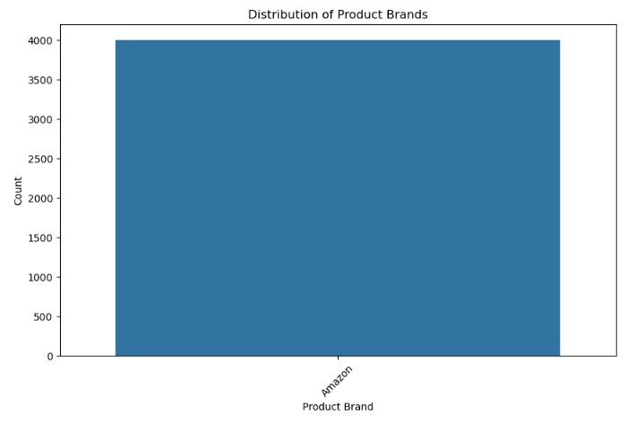
Distribution of Product Brands
The distribution of product brands refers to the breakdown of mentions or occurrences of different brands within a dataset, typically in the context of reviews, social media posts, or other forms of text data. Understanding the distribution of product brands can provide insights into market share, brand popularity, and consumer sentiment towards specific brands.

Slide 5
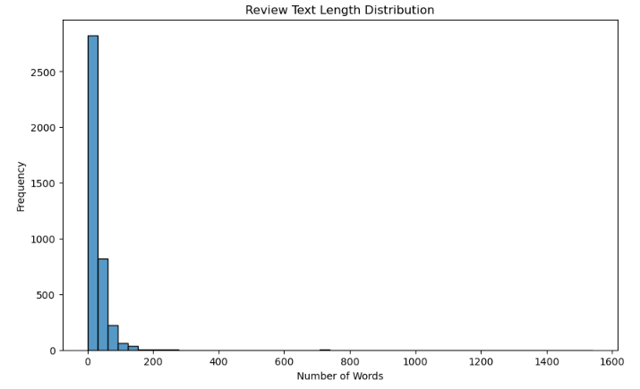
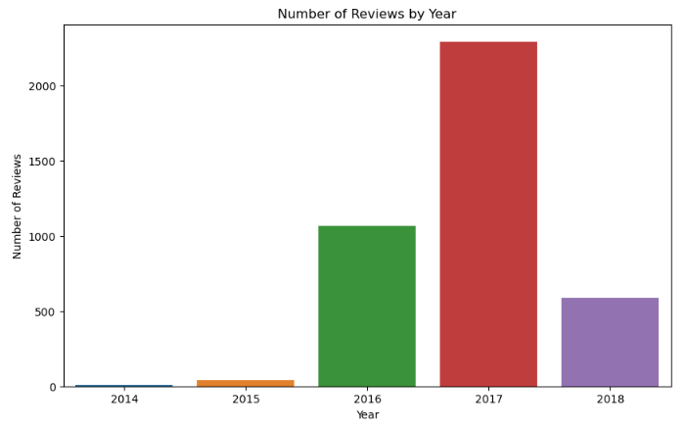
Review Text Length Distribution Number of Reviews by Year

Slide 6
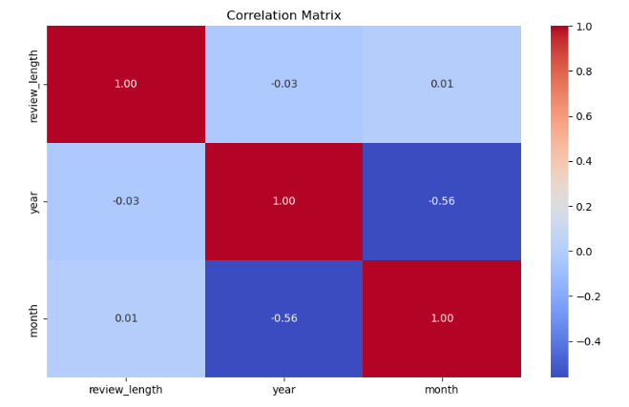
Correlation Matrix
A correlation matrix is a table that shows the correlation coefficients between variables in a dataset. Each cell in the table represents the correlation coefficient between two variables. The correlation coefficient measures the strength and direction of the linear relationship between two or more variables. It ranges from -1 to 1

Slide 7
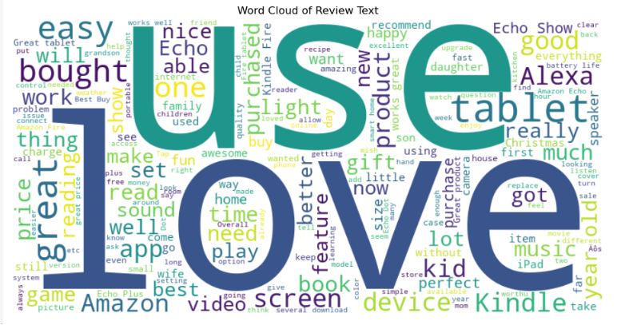
Word Cloud of Review Text
A word cloud of review text is a visually appealing way to represent the most frequently occurring words in a collection of reviews

Slide 8
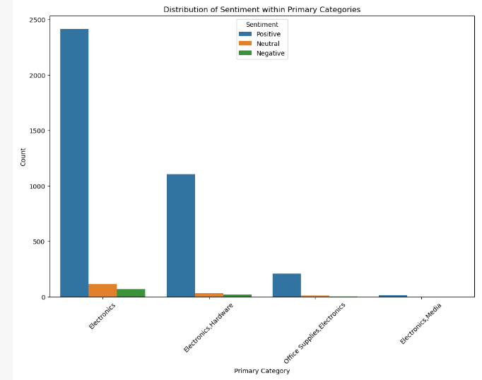
Distribution of Sentiment within Primary Categories
The "Distribution of Sentiment within Primary Categories" refers to the breakdown of sentiment analysis results within different primary categories or groups. This analysis involves categorizing text data into distinct primary categories or groups and then determining the distribution of sentiment (positive, negative, neutral) within each category.

Slide 9
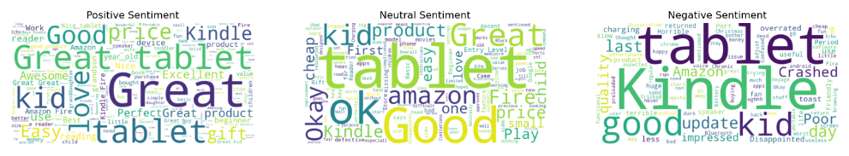
Review Title Word Clouds for Electronics
Review Title Word Clouds for Electronics" refers to the creation of word clouds specifically based on the titles of reviews related to electronic products. This analysis involves extracting the titles of reviews associated with electronics, processing the text data, and generating a word cloud visualization to highlight the most common words or phrases used in these titles

Slide 10
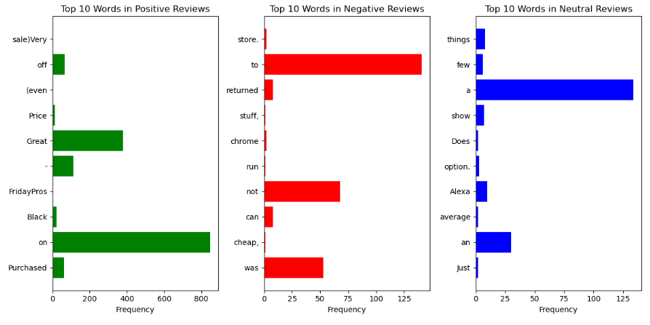
Top 10 Words of Positive Reviews, Negative Reviews and Neutral Reviews
Top 10 Words of Positive Reviews, Negative Reviews, and Neutral Reviews" refers to the identification of the most frequently occurring words in each sentiment category within a set of reviews. This analysis aims to uncover the distinctive language used in reviews expressing different sentiments (positive, negative, and neutral).

Slide 11
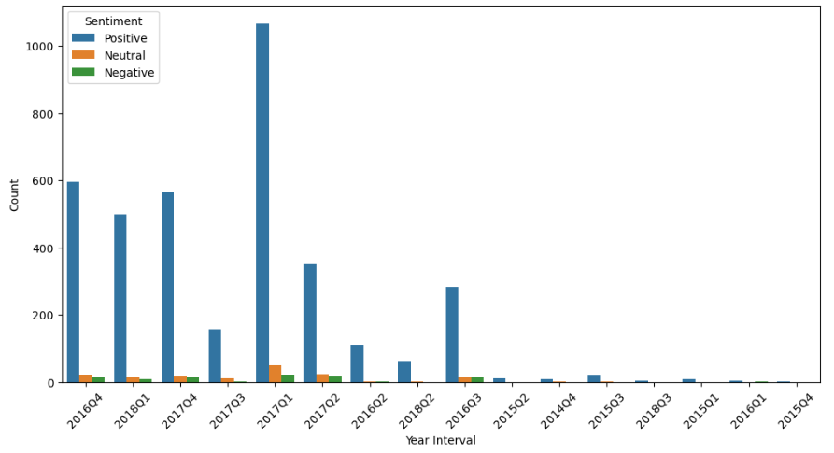
Sentiment Distribution Over Time Intervals
Sentiment distribution over time intervals refers to the analysis of how sentiment (positive, negative, neutral) varies or evolves over different periods of time. This analysis involves examining the sentiment of text data (such as reviews, social media posts, news articles) within specific time intervals, which could be days, weeks, months, or any other predefined time periods.

Slide 12
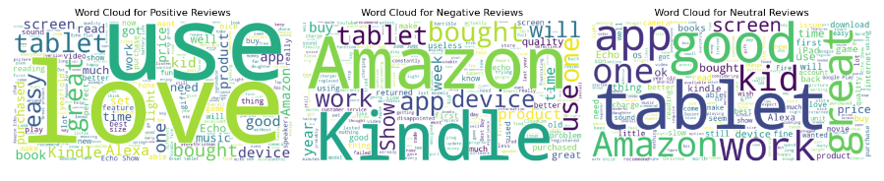
Word Cloud for Positive Reviews, Negative Reviews and Neutral Reviews
A "Word Cloud for Positive Reviews, Negative Reviews, and Neutral Reviews" is a visual representation that displays the most frequently occurring words or phrases in each sentiment category (positive, negative, and neutral) of a set of reviews. This type of analysis provides a quick and intuitive way to identify the key themes or topics associated with each sentiment category.

Slide 13
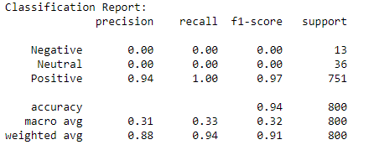
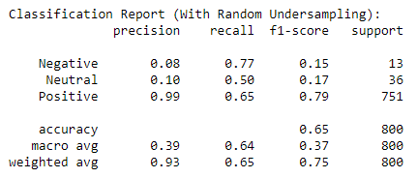
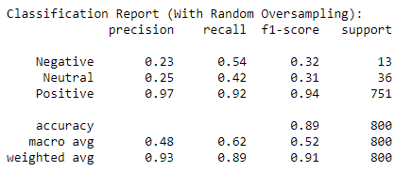
Classification Report
A classification report is a summary of the performance of a classification model that is used to evaluate the quality of predictions made by the model on a test dataset. It provides several metrics that help assess how well the model is performing in terms of classification accuracy and other key indicators
Random Undersampling Random Oversampling

Slide 14
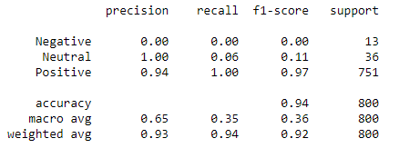
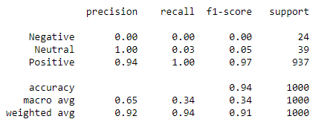
Evaluation Metrics
These evaluation metrics are commonly used to assess the performance of classification models across various domains and tasks. They provide valuable insights into different aspects of model performance, such as accuracy, ability to identify positive instances, and balance between precision and recall.

Slide 15
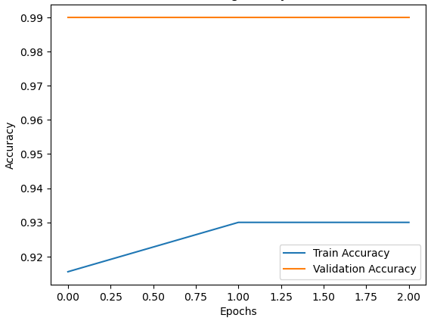
Training History

Slide 16
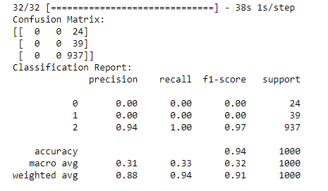
The Classification Report of sentiment analysis
The classification report of sentiment analysis providing a comprehensive summary of the performance of a sentiment analysis model across multiple evaluation metrics.
Precision measures the accuracy of positive predictions made by the model
Recall measures the ability of the model to correctly identify positive sentiment instances out of all actual positive sentiment instances in the dataset
The F1-score is the harmonic mean of precision and recall. It provides a balance between precision and recall and is particularly useful when there is an imbalance between the number of positive and negative sentiment instances in the dataset
Support refers to the number of actual occurrences of each sentiment class in the dataset. It provides context for the precision, recall, and F1-score by indicating the relative frequency of each sentiment class

Slide 17
Thank You 🙏 Made by :- Ankur Kumar

